Slide 1
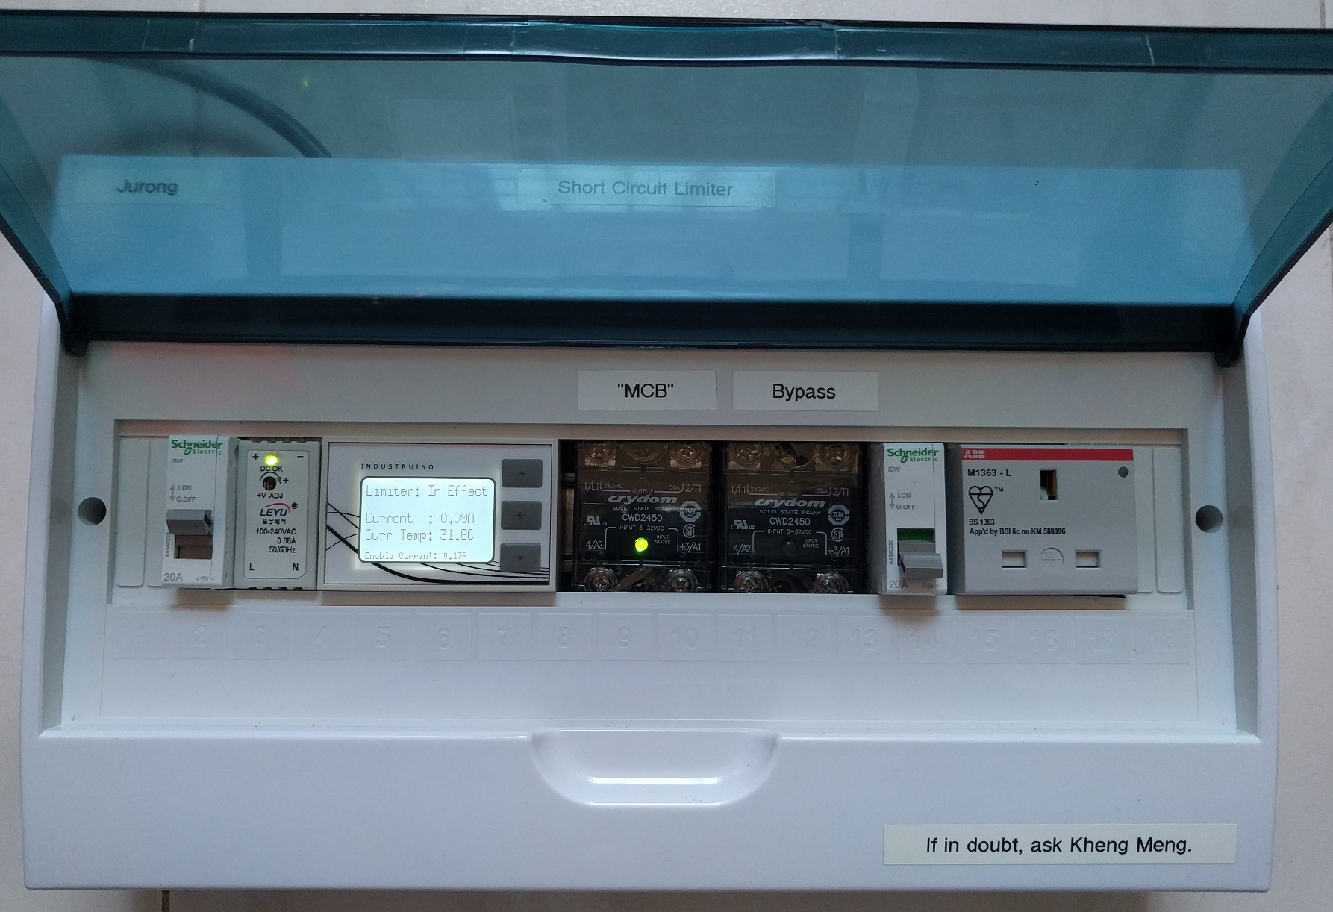
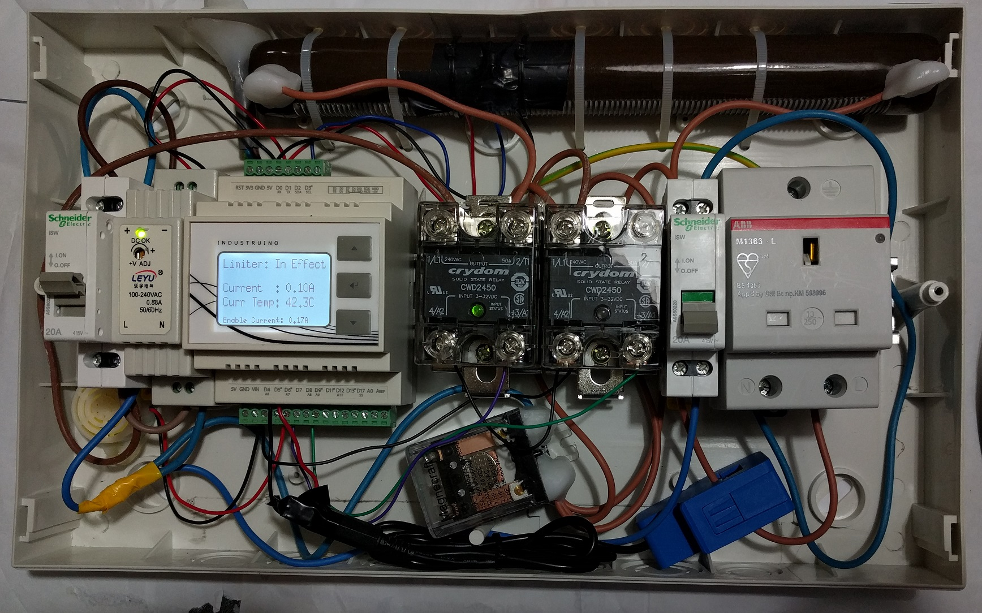
Repair Kopitiam specialty electrical tools (Part 2): Short Circuit Limiter
By: Yeo Kheng Meng (yeokm1@gmail.com)
https://github.com/yeokm1/repair-kopitiam-training-and-equipment/tree/master/short-circuit-limiter
http://yeokhengmeng.com/2017/07/repair-kopitiam-specialty-electrical-tools-part-2-short-circuit-limiter/
Hackware v3.4 (6 Sept 2017)

Slide 2


Background
Sustainable Living Lab (SL2)
Social Enterprise
“Aims to build a Sustainable Future through community building, technology experimentation and social innovation.”
http://www.sl2square.org/
Repair Kopitiam (RK)
Voluntary initiative started in Nov 2014
Combat the Buy-and-Throw-Away culture
Monthly event to guide residents to repair their items
Repair Coaches and not repairmen
http://repairkopitiam.sg/

Slide 3




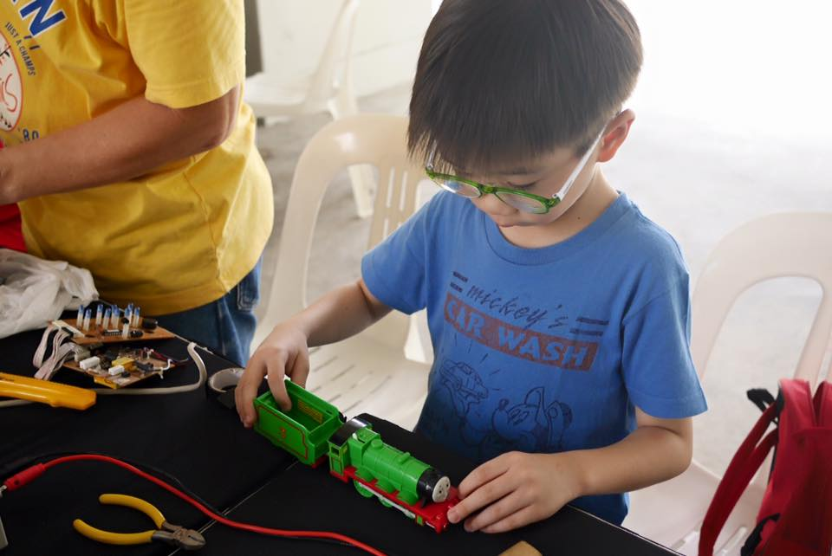
Photos

Slide 4
Agenda
Fundamental Knowledge
Problem
Solution

Slide 5
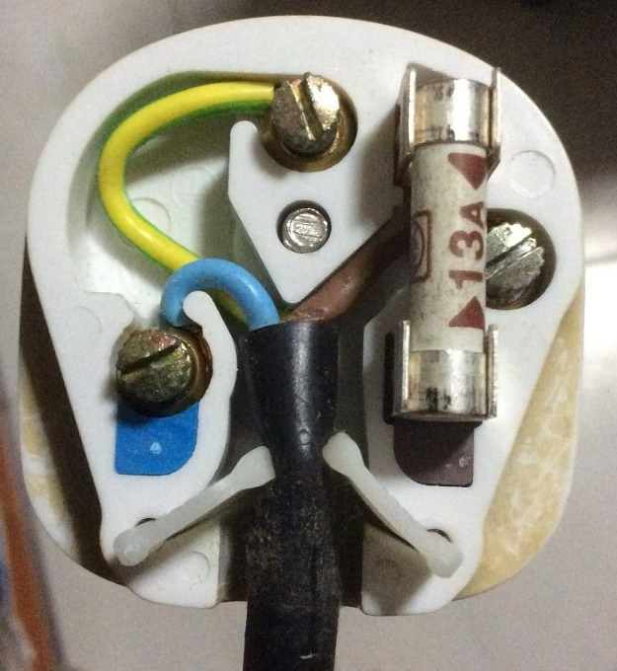
Inside the 3-pin mains plug (BS1363)
Earth
Yellow/Green
Connects to appliance’s external case, protects user from electric shock
Fuse
Blows on overcurrent
Usually 13A
Live
Brown/Red
Source of power
Neutral
Blue/Black
Completes the circuit to generator
Tied to ground at power distribution box to ensure stable 0V

Slide 6
Earth connections: Normal operation
Kettle
Mains Live
Fuse
230V
AC ~
Mains Neutral
Mains Earth
Earth

Slide 7
Live wire touches case
X
Kettle
Mains Live
Fuse
230V
AC ~
Mains Neutral
Mains Earth
Earth

Slide 8
What if there is no Earth wire?
Kettle
Mains Live
Fuse
230V
AC ~
Mains Neutral
Earth

Slide 9
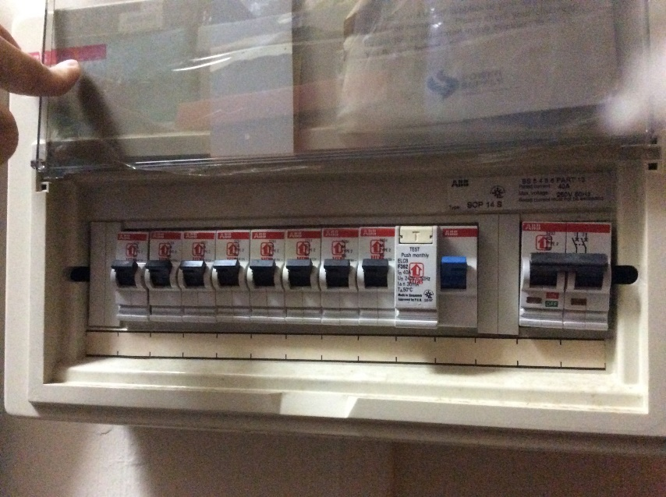
MCB + RCCB Circuit Breakers
MCB
RCCB
Residual Current Circuit Breaker (RCCB)
What it does? Breaks the circuit on earth fault
Cause: Current leakage to Earth
When?: Breaks when current difference between
(|live| - |neutral|)> 30mA threshold
Miniature Circuit Breakers (MCBs)
Breaks the circuit on overcurrent eg. short circuit

Slide 10
Circuit breaker arrangement
Mains Live
Kettle
MCB
RCCB
Fuse
230V
AC ~
Mains Neutral
Mains Earth
Earth
Residual Current Circuit Breaker (RCCB)
What it does? Breaks the circuit on earth fault
Cause: Current leakage to Earth
When?: Breaks when current difference between
|live – neutral|> 30mA threshold
Miniature Circuit Breakers (MCBs)
Breaks the circuit on overcurrent eg. short circuit

Slide 11
Residual Current Circuit Breaker with Overload Protection (RCBO)
Mains Live
Kettle
RCBO
Fuse
230V
AC ~
Mains Neutral
Mains Earth
Earth
RCBO = RCCB + MCB

Slide 12
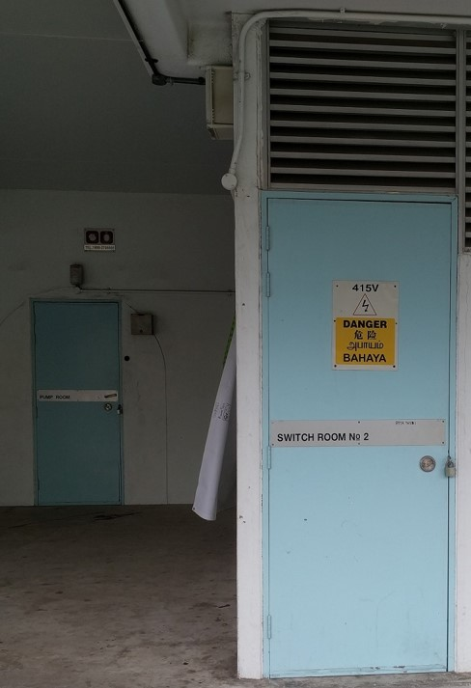
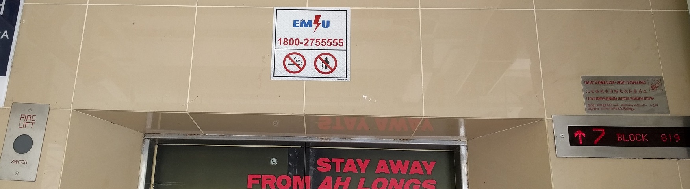
Problem: Inaccessible onsite breaker
Circuit breaker inside locked electrical room
Call Essential Maintenance Service Unit (EMSU) to unlock
30-60 mins response time

Slide 13
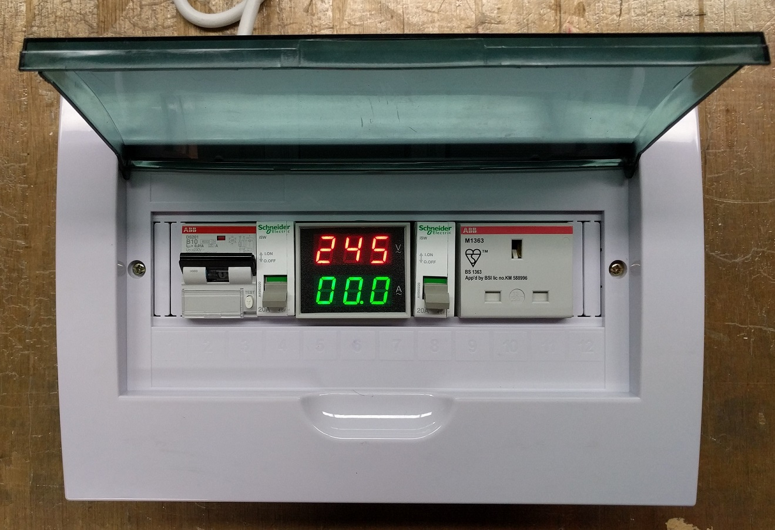
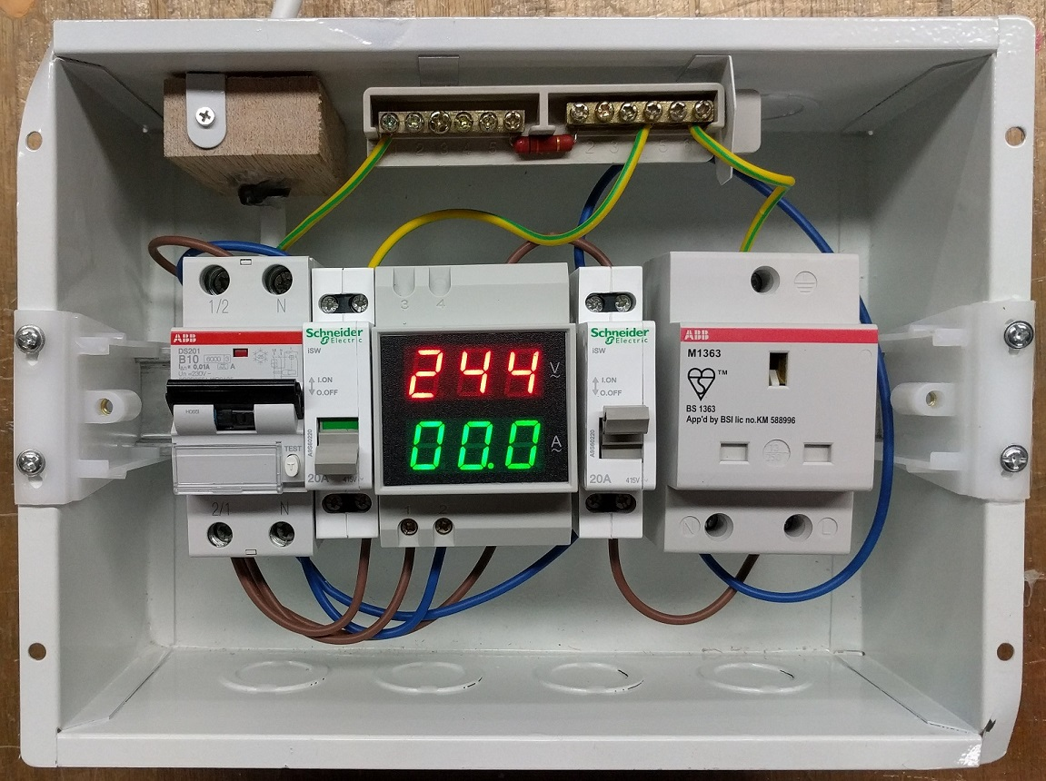

Solution to prevent RCCB trip
10mA RCBO (30mA typical)
20K ohm resistor on Earth line:$\frac{230V}{20000Ω}=11.5mA$ fault current
Hackware v2.0 (July 2016): https://engineers.sg/v/920

Slide 14
Solution to prevent MCB trip (Demo Video)
Video URL: https://www.youtube.com/watch?v=VpU6cOnxy0s
20 seconds startup time to let current measurement settle. Notice the left relay is kept off till startup is done.
Turn on a lamp: There is a 1 second delay between turning on the lamp and the second relay being turned on. Also notice the display backlight turns on and the buzzer buzzes once.
Turn off the lamp: The display backlight turns off immediately and the buzzer buzzes twice.
Repeat steps 2 and 3 for the hair dryer. Notice the motor sound is lower during the 1 second period.
Short circuit with a cable with its live and neutral pins shorted. The moment the switch is turned on, the device cuts off power to the outgoing socket. The buzzer also buzzes for a long 2 seconds. Notice the onsite MCB in the room did not trip as the device is still on.
Reset the device with just a simple button press.

Slide 15
Design goals
(Primary goal) Prevent onsite MCB trip yet cut power to maintain safety
Should not adversely affect operation of downstream appliances
Safety protection on overheat (to be explained)

Slide 16
How to get started?
Inrush Current Limiter:
https://en.wikipedia.org/wiki/Inrush_current_limiter
Fixed resistors are also widely used to limit inrush current. These are inherently less efficient, since the resistance never falls from the value required to limit the inrush current… They can be switched out of the circuit using a relay or MOSFET though, after inrush current is complete.

Slide 17
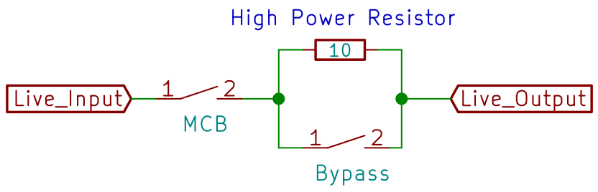
Proposed Design (State 0)
MCB Relay
Bypass Relay
10-ohm resistor

Slide 18
Proposed Design (State 1)
MCB Relay Closed
Bypass Relay Open

Slide 19
Proposed Design (State 2a)
Appliance connected and 1 second of no short circuit
Bypass Relay closes -> Full current
If appliance turns off, go back to State 0

Slide 20
Proposed Design (State 2b)
If short circuit happens, MCB relay opens
MCB relay closes only if user resets the system

Slide 21
Implementation
AC-DC 5V Transformer
Microcontroller
10-ohm resistor
Solid State Relays
Mechanical Relay
Current Transformer (CT) Clamp

Slide 22
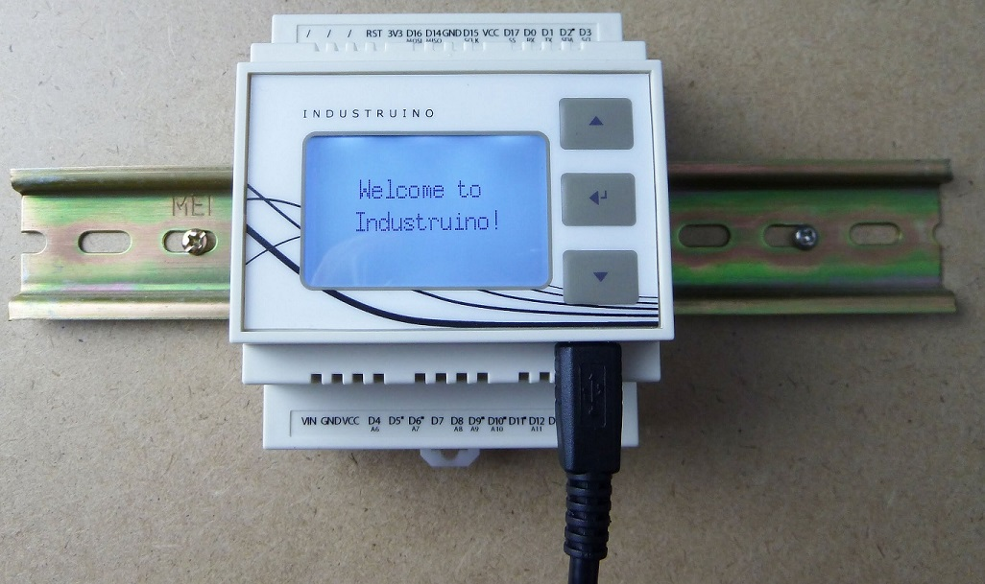
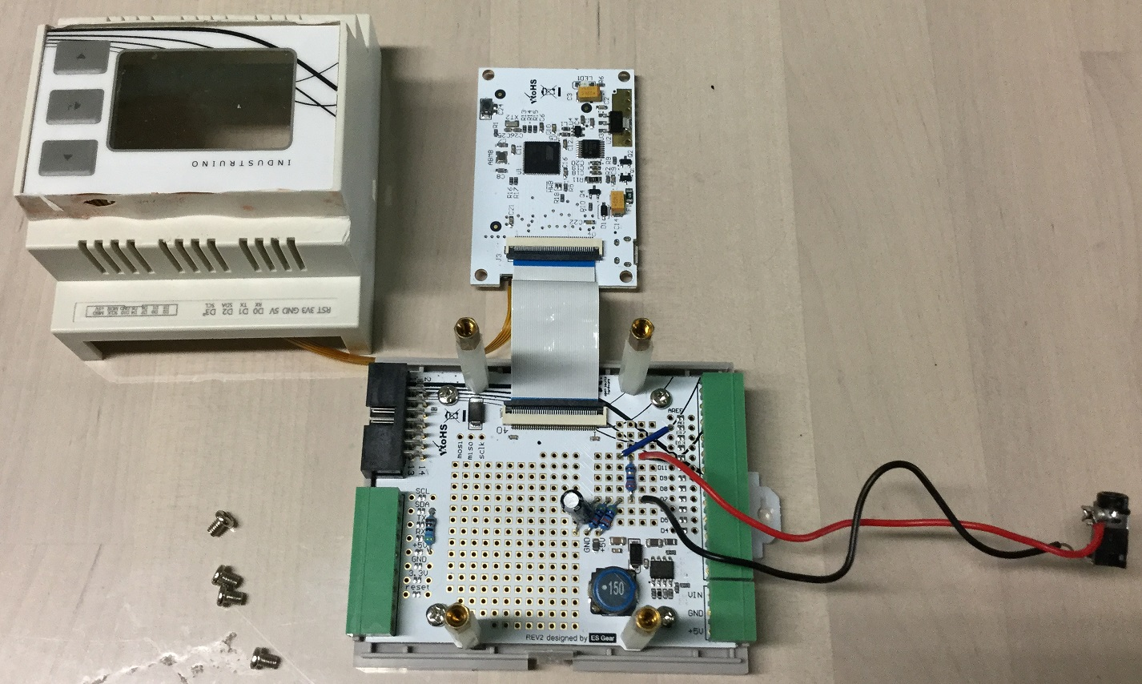
The brain: Industruino-1286
Arduino on a 35mm DIN rail
Atmel AT90USB1286: 8-bit AVR, 128KB Flash
LCD + buttons + prototyping space
https://industruino.com/

Slide 23
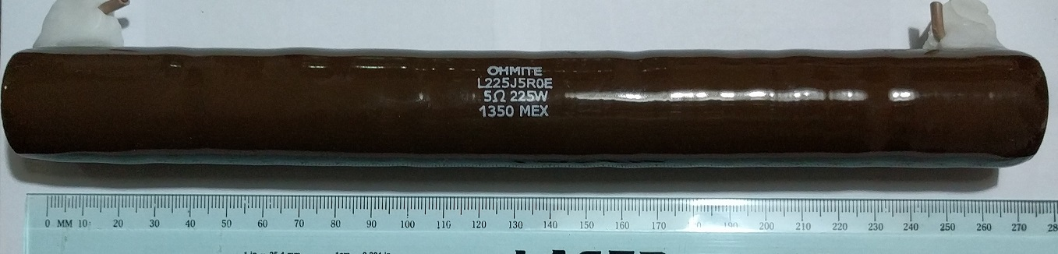
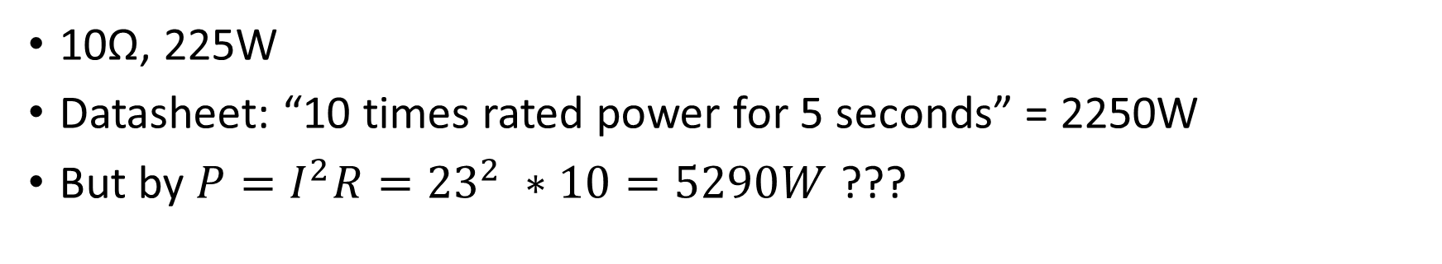
High Power Resistor
10Ω, 225W
Datasheet: “10 times rated power for 5 seconds” = 2250W
But by $P=I^{2}R={23}^{2} ∗10=5290W$ ???

Slide 24
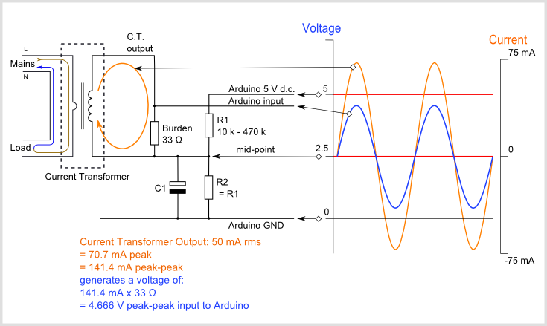
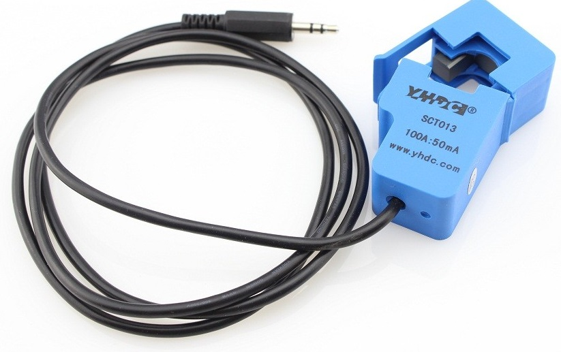
Current Measurement
Determine appliance is on/off
Detect overcurrent
CT Clamp
-> Signal Conditioning
-> Microcontroller ADC

Slide 25
Signal Conditioning
CT Clamp 2000: 1 -> 100A: 50mA
Bias voltage divider: 2x 470kΩ
Burden resistor: 33Ω
https://learn.openenergymonitor.org/electricity-monitoring/ct-sensors/interface-with-arduino

Slide 26
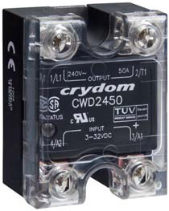
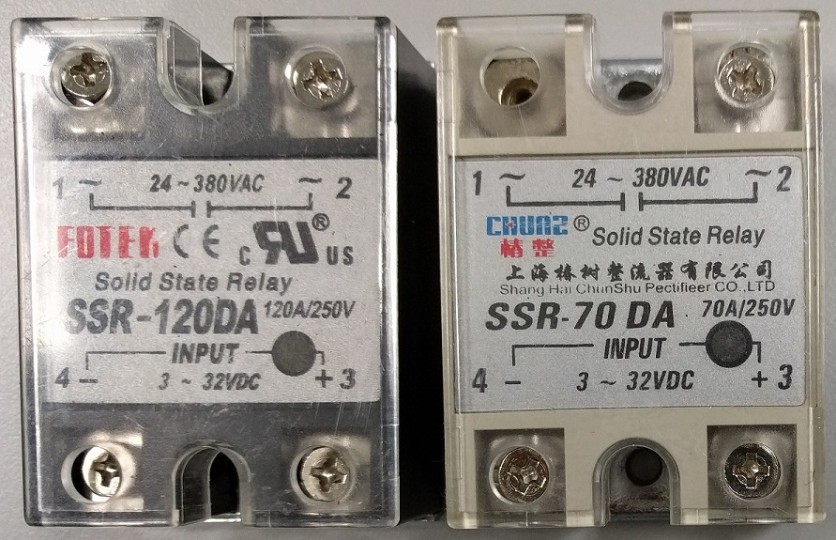
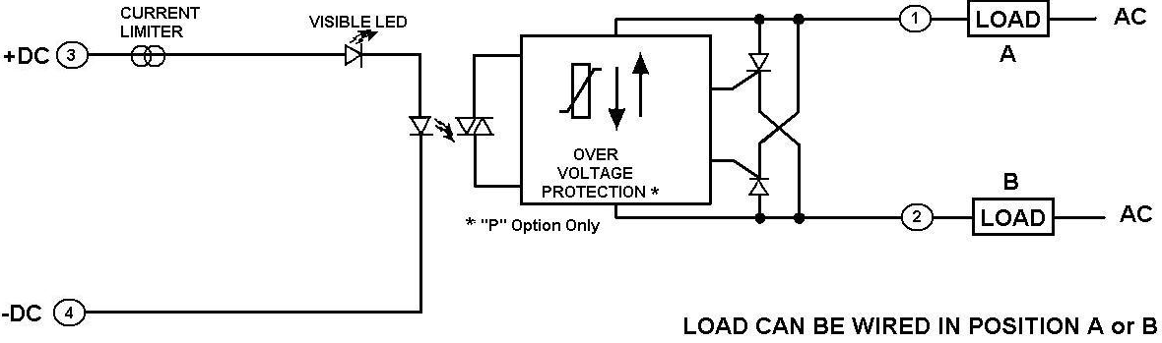
Switching On/Off
Just use a solid-state relay (SSR)?
Opto-isolator -> photodiode
-> Silicon Controlled Rectifier

Slide 27
Problem: SSR does not turn off
Possible Explanation?
“Reset Failure due to Solid-state Relay Leakage Current Even when there is no input signal to the Solid-state Relay there is a small Leakage Current (IL) from the Solid-state Relay output (LOAD). If this Leakage Current is larger than the load release current, the Solid-state Relay may fail to reset.”
Problem source:
10Ω resistor parallel to SSR
“Helical wire wound resistors are especially prone to having significant parasitic inductances, because of their coil shape.”
Explanation Source: http://www.omron-ap.com/service_support/FAQ/FAQ02155/index.asp
Inductance explanation: http://www.resistorguide.com/inductance/

Slide 28
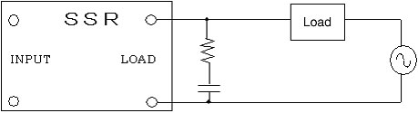
Possible solution?
Resistor-capacitor (RC) snubber on SSR output to suppress sudden voltage changes
Resistor value chosen to match the load
But the actual load on the live output is unknown…

Slide 29
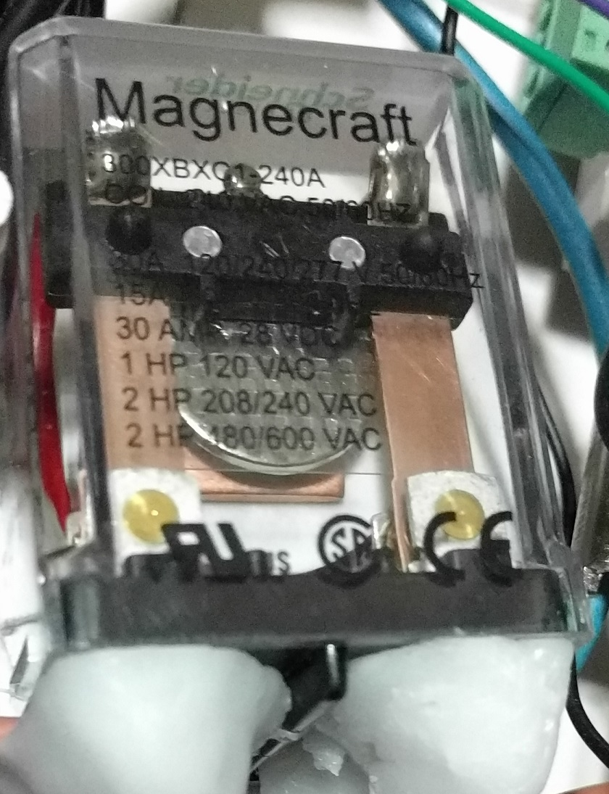
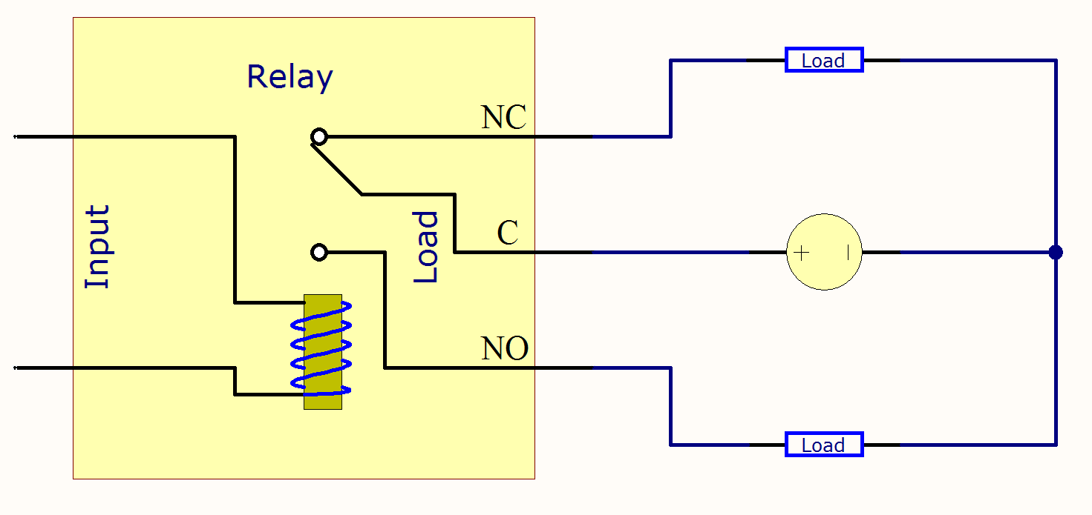
Implemented Solution: Mechanical Relay
Magnecraft/Schneider Electric 300XBXC1-240A
240VAC Control and Load Coil
SSR controls this mechanical relay
Deterministic, no worries on output load
Lifespan: 5 million cycles ≈ 1 cycle / 6 seconds -> 1 year
Image Source: https://www.phidgets.com/docs/Mechanical_Relay_Primer

Slide 30
Mechanical relay
Video URL: https://www.youtube.com/watch?v=QWAE_0n4-p0

Slide 31
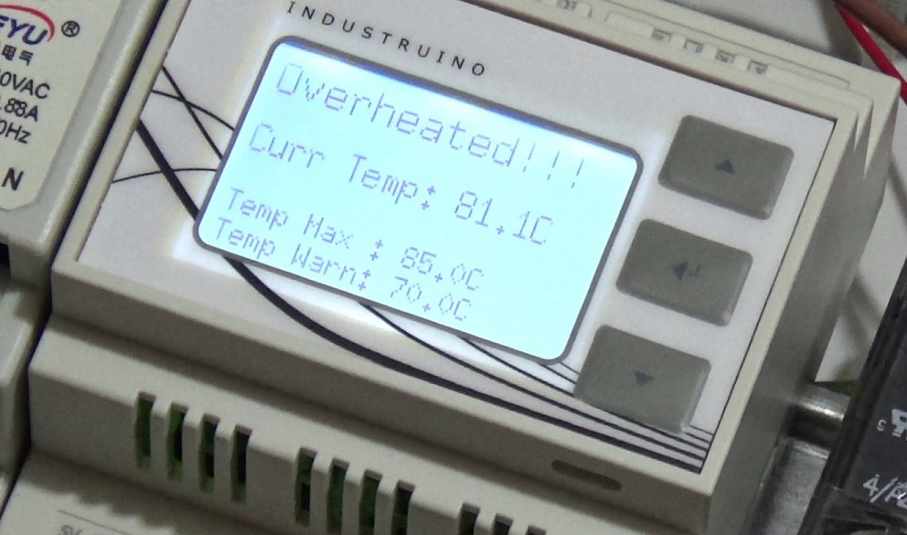
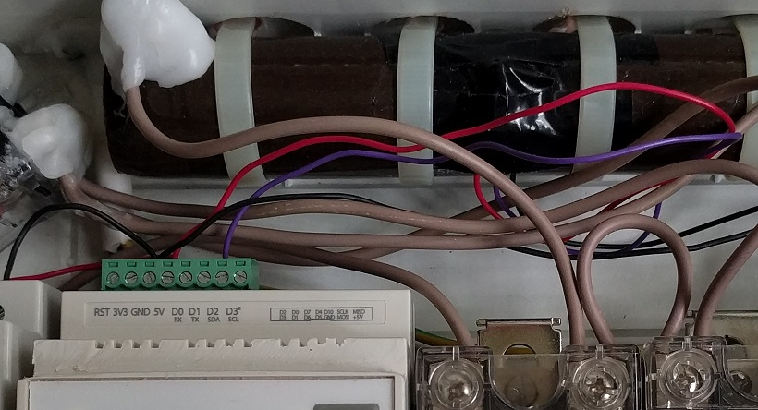
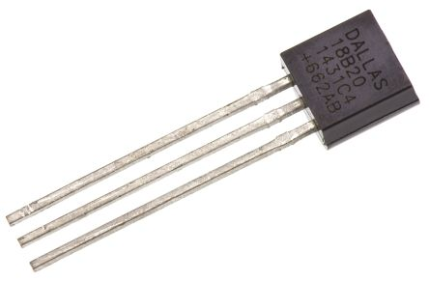
Resistor Overheat Alert
Maxim/Dallas DS18B20+ 1-Wire temperature sensor
70°C buzzer/blink warning
85°C function ceased till temperature < 70°C
Video URL: https://www.youtube.com/watch?v=O4qB3WehqlA

Slide 32
System weakness
Short Circuit after Resistor has been bypassed
Multiple downstream appliances

Slide 33
Next Repair Kopitiam
Every last Sunday of the month
10am to 3pm, Sunday 27 Sept 2017
Locations:
Block 444 Jurong West Ave 1
Block 897A Tampines Street 81
https://www.facebook.com/repairkopitiam/
FB Group on Repair Advice and queries
Love Your Barang? Fix Your Barang! By Repair Kopitiam
https://www.facebook.com/groups/1611578529156041/
New volunteers WELCOME!

Slide 34
Cheap relays vs branded relays?
Cheap relays allow current to flow through at the start even with control coil disconnected
Chinese relays: $10-$20
Branded Crydom: $60

Slide 35
One year long development time
Cannot experiment at home due to trips
Have to go to UWC East regularly for testing
RK is held only once a month

